Slide 1




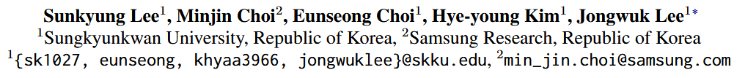



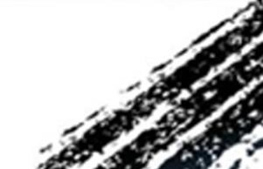

ATAI
Advanced Technique of Artificial Intelligence
ATAI
ChongqingUniversity _{AdvancedTechniqueof}
of Technology Artificial Intelligence
Chongqing University of
Technology
Chongqing University ^{ATAI}
_{of Technology} Advanced Techniqueof
Artificial Intelligence
Chongqing University of Technology
Chongqing University of Technology
GRAM: Generative Recommendation via Semantic-aware Multi-granular Late Fusion
——ACL_2025
Reported by Mingyu Yang
1
Notes:
Q1:认真的讲述一次，从头开始讲。
Q2：M->u 与U->m的区别

Slide 2
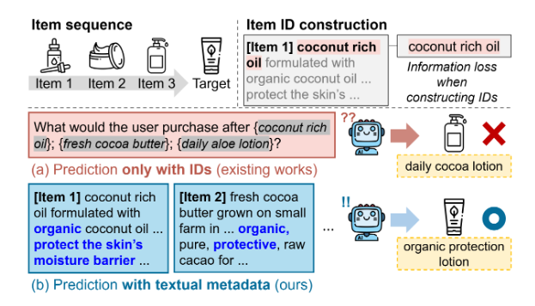
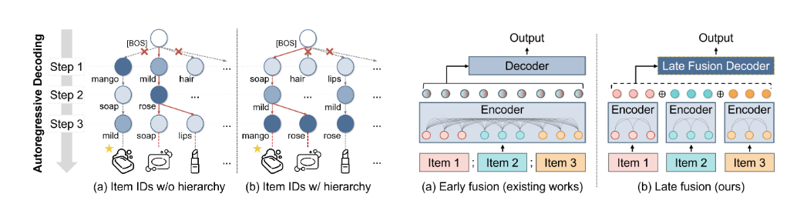
ATAI
Advanced Technique of Artificial Intelligence
ATAI
ChongqingUniversity _{AdvancedTechniqueof}
of Technology Artificial Intelligence
Chongqing University of
Technology
Chongqing University ^{ATAI}
_{of Technology} Advanced Techniqueof
Artificial Intelligence
Chongqing University of Technology
Chongqing University of Technology
Motivation
Existing generative recommendation systems face two fundamental challenges when leveraging large language models (LLMs) for recommendation tasks:
1)Difficulty in capturing implicit item relationships；
2)Ineffective handling of lengthy item information.
Notes:
总评分怎么得到的? 其实中间的图片还可以说明使用多准则推荐可以发现两个总评分相等，但兴趣不同的情况。用户通常倾向于对他们喜欢或不喜欢的项目进行评分。这种自发行为可能导致典型的选择偏差。现有研究通常在拆分MC评级后引入传统的相似性度量，并通过聚合函数（如加权求和）实现预测

Slide 3
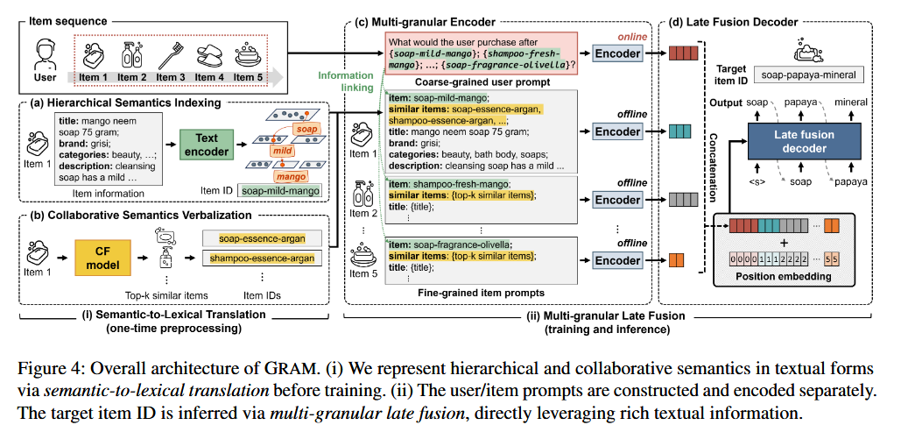
ATAI
Advanced Technique of Artificial Intelligence
ATAI
ChongqingUniversity _{AdvancedTechniqueof}
of Technology Artificial Intelligence
Chongqing University of
Technology
Chongqing University ^{ATAI}
_{of Technology} Advanced Techniqueof
Artificial Intelligence
Chongqing University of Technology
Chongqing University of Technology
Overview
Notes:
U跟R并不是直接关联，因为R是多个准则评分算出来的，U与R中间是含有M，形成一个伪关联，当M出现问题，会导致预测不准。切断M到U是因为R是直接被M影响的 R：{R0, R1, . . . , RK }, M：1*K，这个1主要看user的数量。
得到两个解法：（1）为了解决M的偏好缺少 对于M取平均值
（2）为了解决M影响U的学习表征

Slide 4
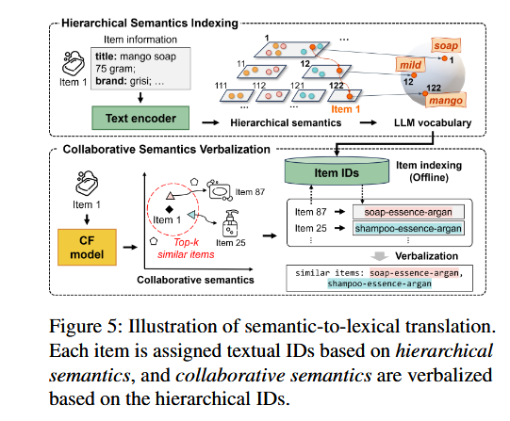
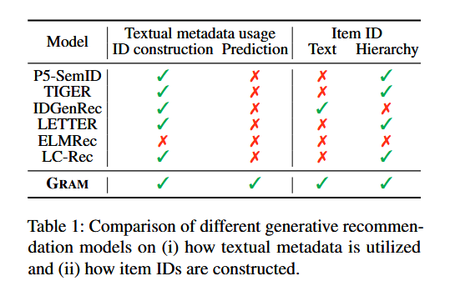
ATAI
Advanced Technique of Artificial Intelligence
ATAI
ChongqingUniversity _{AdvancedTechniqueof}
of Technology Artificial Intelligence
Chongqing University of
Technology
Chongqing University ^{ATAI}
_{of Technology} Advanced Techniqueof
Artificial Intelligence
Chongqing University of Technology
Chongqing University of Technology
Method

Slide 5











ATAI
Advanced Technique of Artificial Intelligence
ATAI
ChongqingUniversity _{AdvancedTechniqueof}
of Technology Artificial Intelligence
Chongqing University of
Technology
Chongqing University ^{ATAI}
_{of Technology} Advanced Techniqueof
Artificial Intelligence
Chongqing University of Technology
Chongqing University of Technology
Method

Slide 6

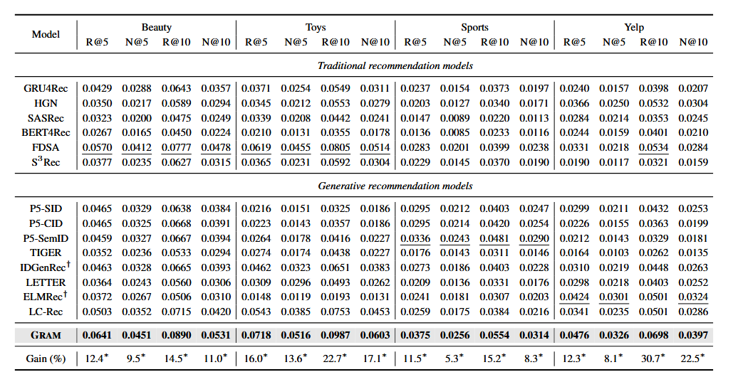
ATAI
Advanced Technique of Artificial Intelligence
ATAI
ChongqingUniversity _{AdvancedTechniqueof}
of Technology Artificial Intelligence
Chongqing University of
Technology
Chongqing University ^{ATAI}
_{of Technology} Advanced Techniqueof
Artificial Intelligence
Chongqing University of Technology
Chongqing University of Technology

Slide 7
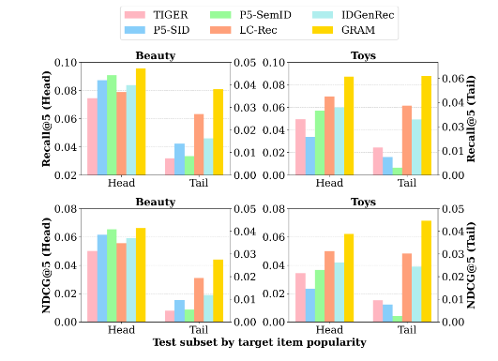
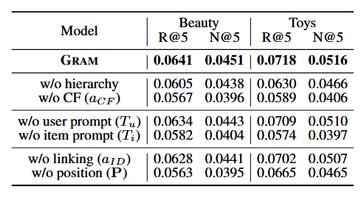
ATAI
Advanced Technique of Artificial Intelligence
ATAI
ChongqingUniversity _{AdvancedTechniqueof}
of Technology Artificial Intelligence
Chongqing University of
Technology
Chongqing University ^{ATAI}
_{of Technology} Advanced Techniqueof
Artificial Intelligence
Chongqing University of Technology
Chongqing University of Technology

Slide 8
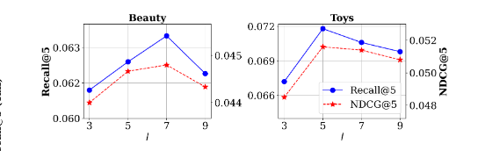
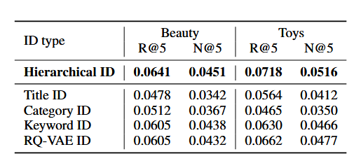
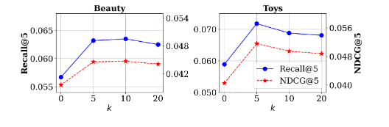
ATAI
Advanced Technique of Artificial Intelligence
ATAI
ChongqingUniversity _{AdvancedTechniqueof}
of Technology Artificial Intelligence
Chongqing University of
Technology
Chongqing University ^{ATAI}
_{of Technology} Advanced Techniqueof
Artificial Intelligence
Chongqing University of Technology
Chongqing University of Technology
Notes:
人为的进行移除数据，按照上面的概率，也相当于充当选择偏差，或者制造偏差

Slide 9


ATAI
Advanced Technique of Artificial Intelligence
ATAI
ChongqingUniversity _{AdvancedTechniqueof}
of Technology Artificial Intelligence
Chongqing University of
Technology
Chongqing University ^{ATAI}
_{of Technology} Advanced Techniqueof
Artificial Intelligence
Chongqing University of Technology
Chongqing University of Technology
Thanks!

